Slide 1
Issue 1
Q1: Is the drop in percent leaf fall of Oak and Beech at the end of the season due to poor data quality/fewer observations?
A: Yes! In the graphs on the next two slides, I’ve plotted a histogram of the number of observations taken on each Julian date and superimposed it on the original leaf fall graph. What they show is that the number of observations reported dropped significantly at the end of the year, and that’s when we get the unexpectedly low values. I have an Idea for how to get around this but didn’t have time to test it out yet.
Q2: What is the gray area on the graph?
A: Your intuition is essentially correct: the blue line is a smoothed Loess regression calculated by R, which uses information from before and after each date to estimate the mean value for that date. The grey area is the 95% confidence interval for that estimation. The black dots are the calculated means using only information from that exact day.

Slide 2
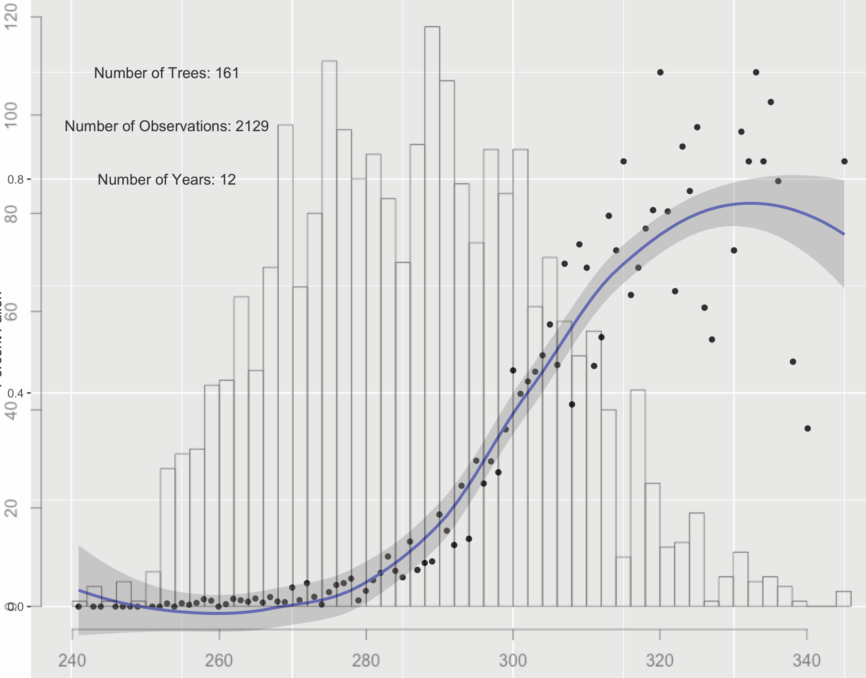
Number of observations and leaf fall, Quercus
Large Numbers: # Entries
Small Numbers: % leaf fall
Julian Date

Slide 3
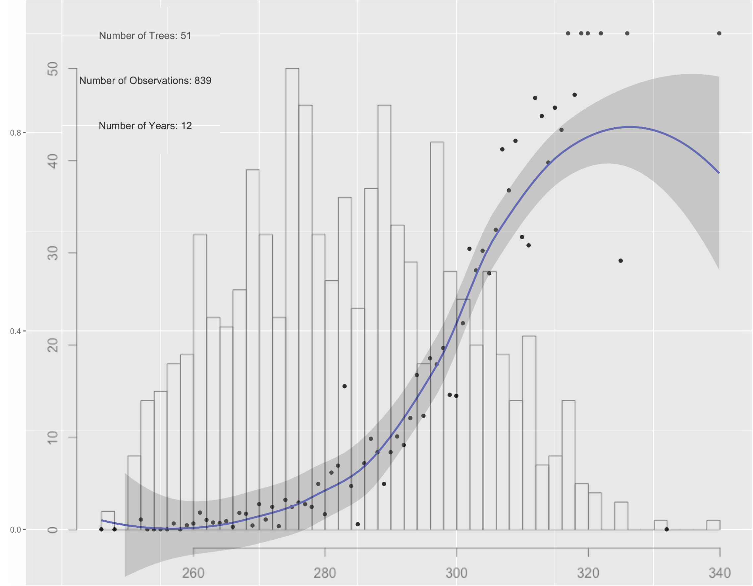
Number of observations and leaf fall, Fagus
Large Numbers: # Entries
Small Numbers: % leaf fall
Julian Date

Slide 4
Issue 2
Q: What is the spatial distribution of trees in the study? (“It would be nice to have a map graph of the most common 3-5 species and have the circles show larger where there are more trees of a certain species”)
A: I looked at the number of individuals of each species, and a natural cutoff seemed to be at 4 species (Red Oak, Red Maple, Sugar Maple, and Beech). I grouped all the trees by town, and plotted circles on those towns with sizes corresponding to how many trees of each species were used. I made two graphs – the first one is of unique trees, and the second is of all observations. So if a certain town had a single Red Maple, it would show as a small circle on the first graph, but if they had followed it for several years and had many records, it would be relatively larger on the second graph. I also included the total numbers next to the key. These graphs can unfortunately be a little hard to read because so many of the points overlap one another.

Slide 5
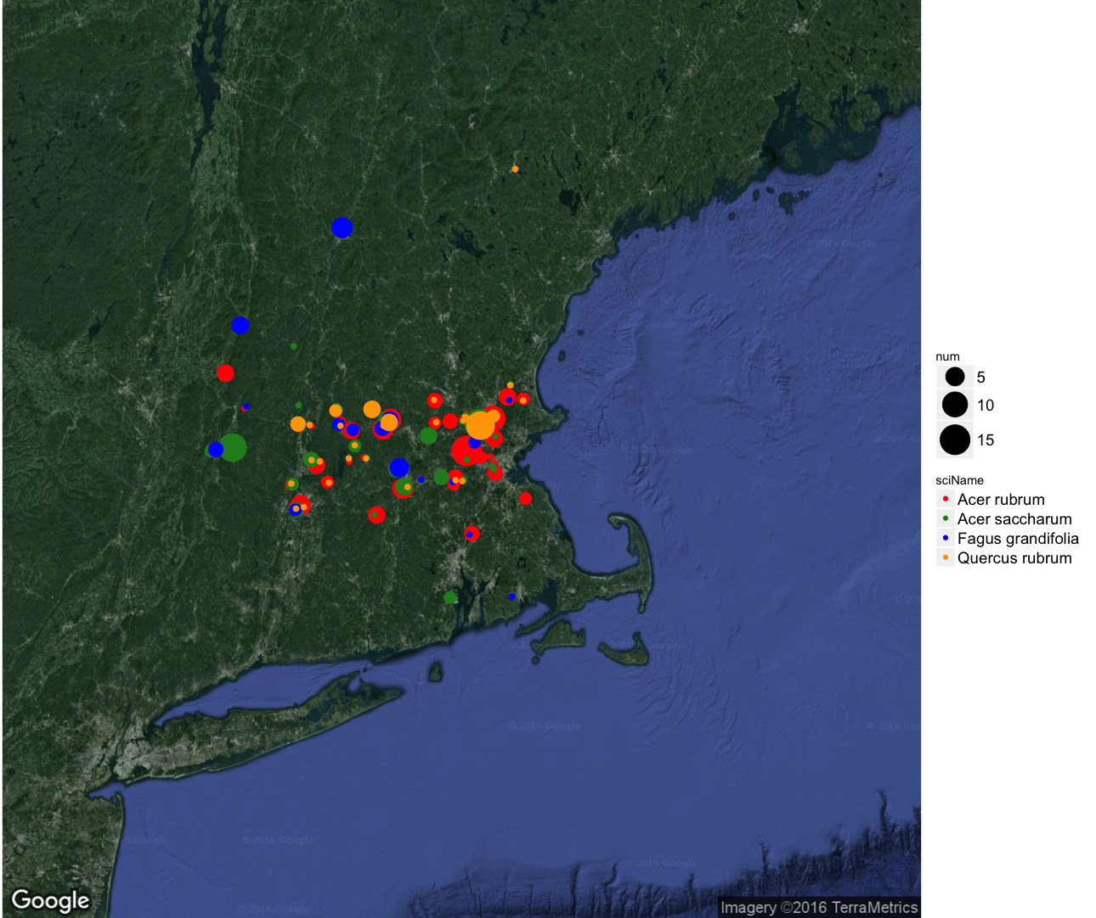
Number and Location of all Trees of Most Common Species in Study Period
Totals
127
87
51
42

Slide 6
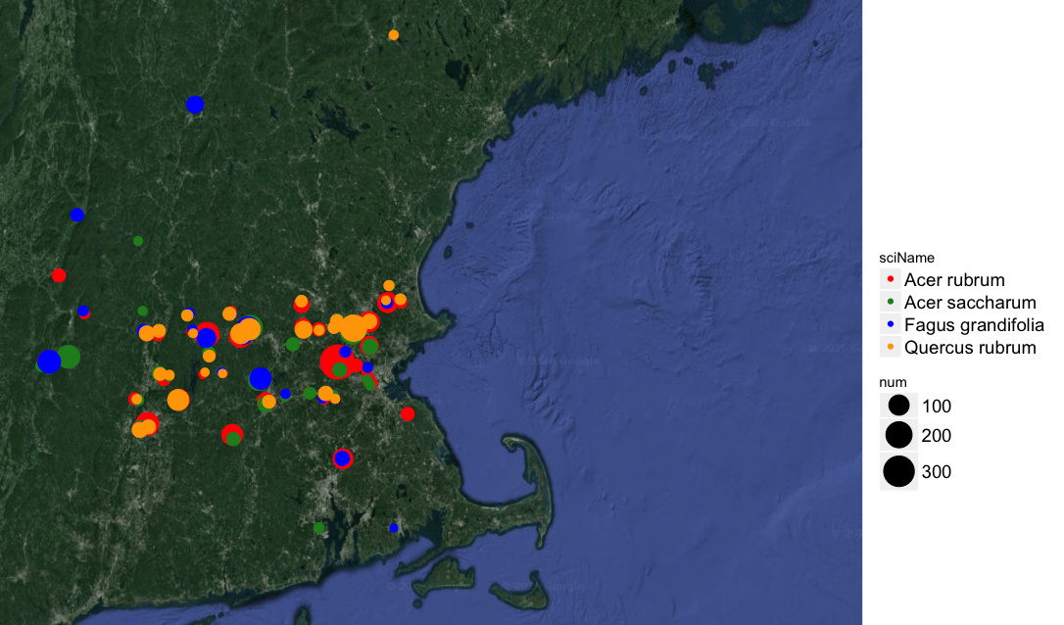
Number and Location of all Observations of Most Common Species in Study Period
Totals
2,259
1,096
839
1,032

Slide 7
Issue 3
Q: Nice graphs, but what about other species (and group by species, not genus)?
A: No problem! I made the JOK-style graphs and the leaf fall curves for each of the four species mentioned above, as well as black birch and black cherry since you mentioned those in the comments.

Slide 8
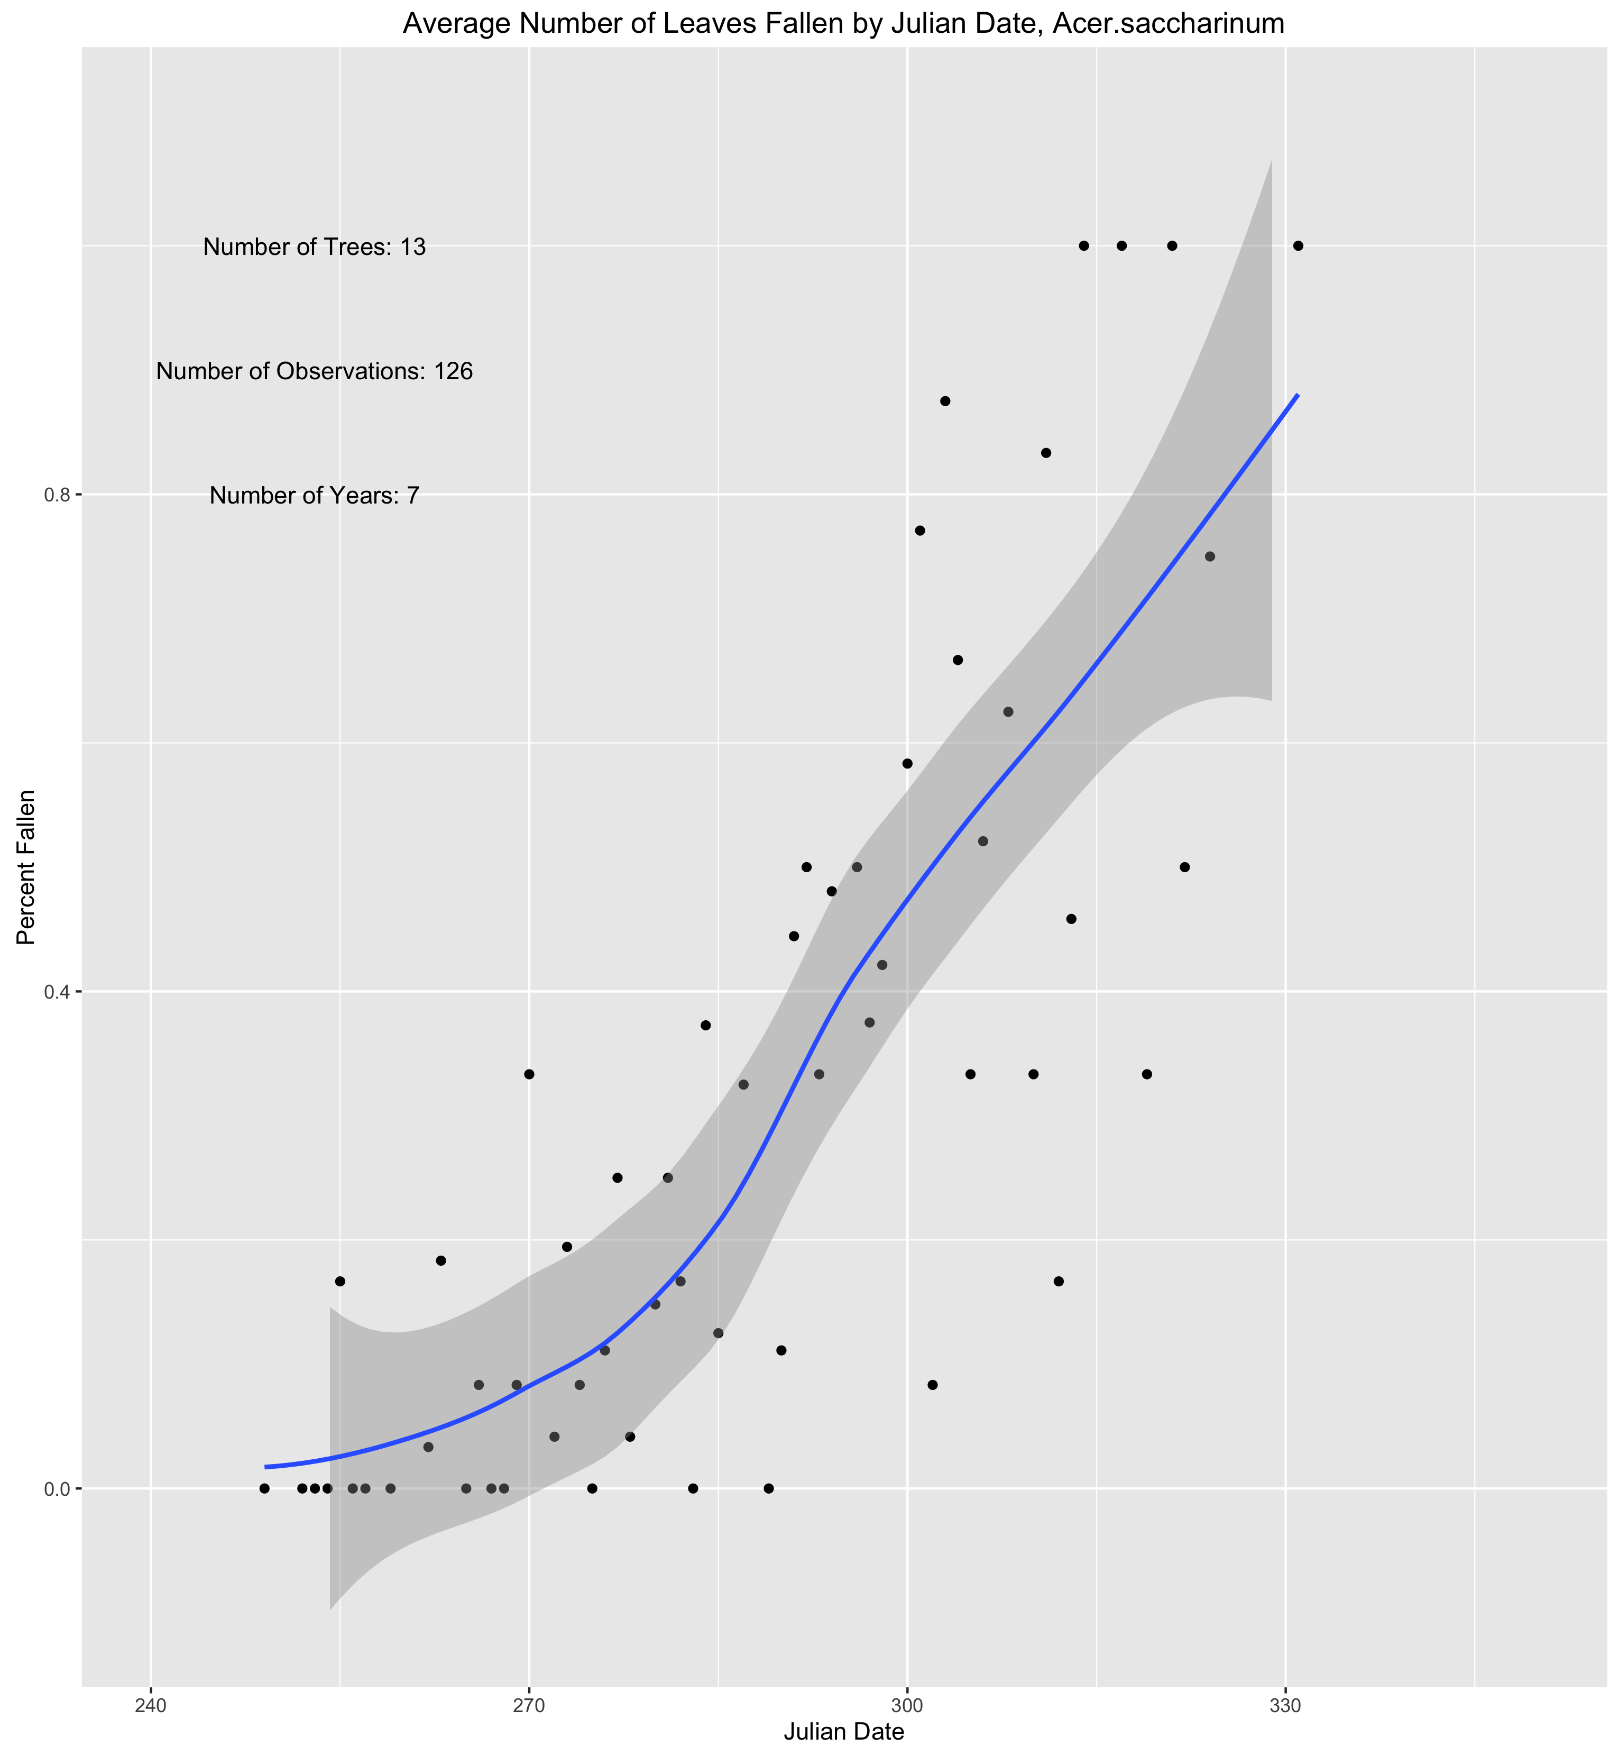
Acer saccharinum

Slide 9
Acer saccharinum

Slide 10
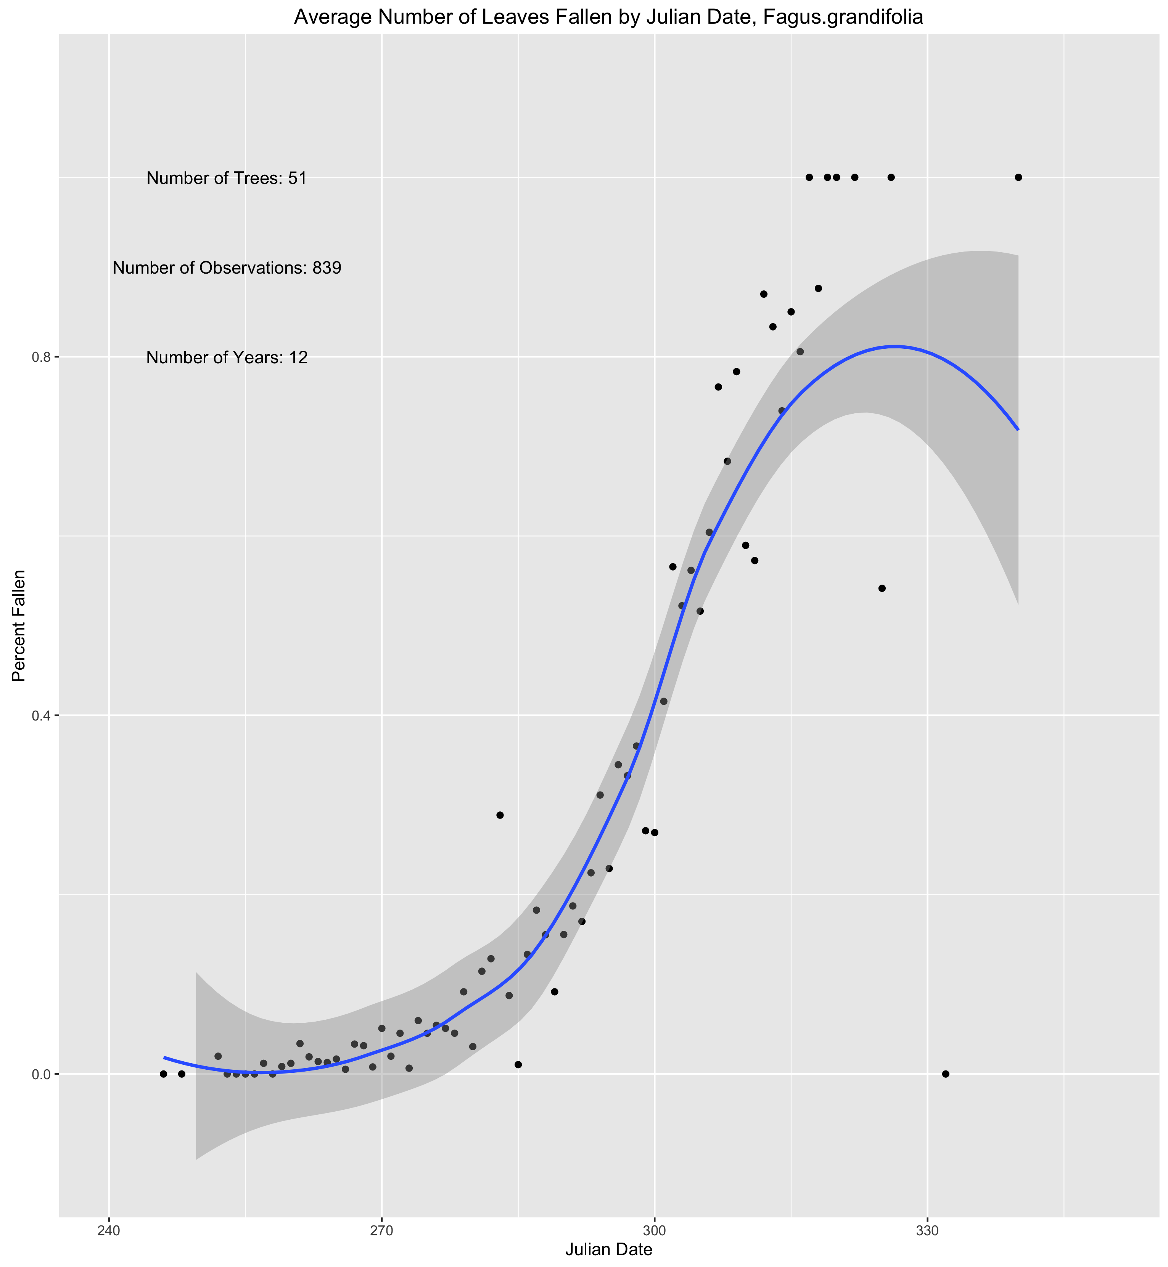
Fagus grandifolia

Slide 11
Fagus grandifolia

Slide 12
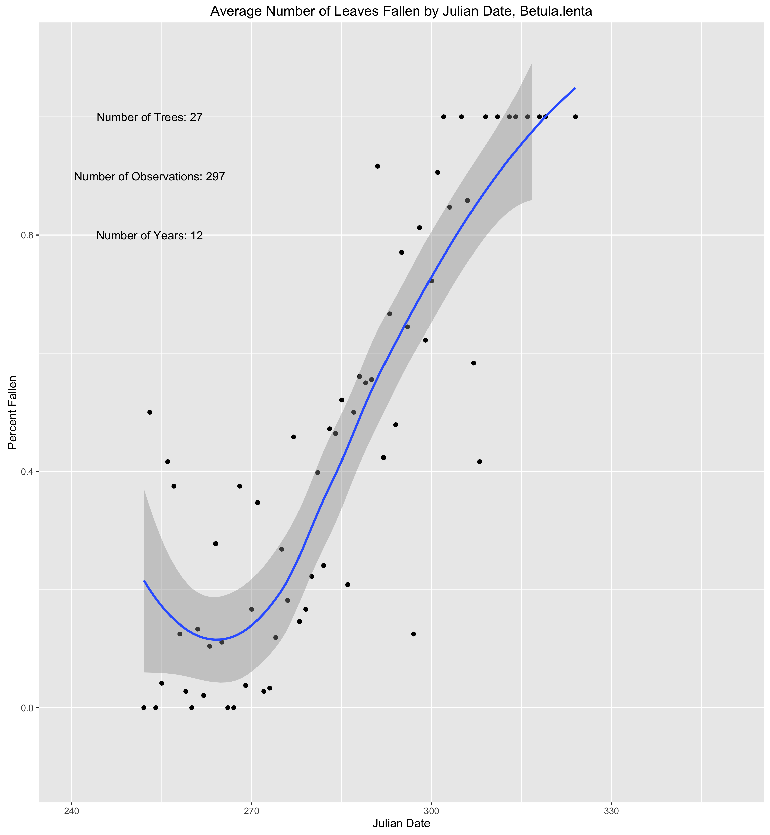
Betula lenta

Slide 13
Betula lenta

Slide 14
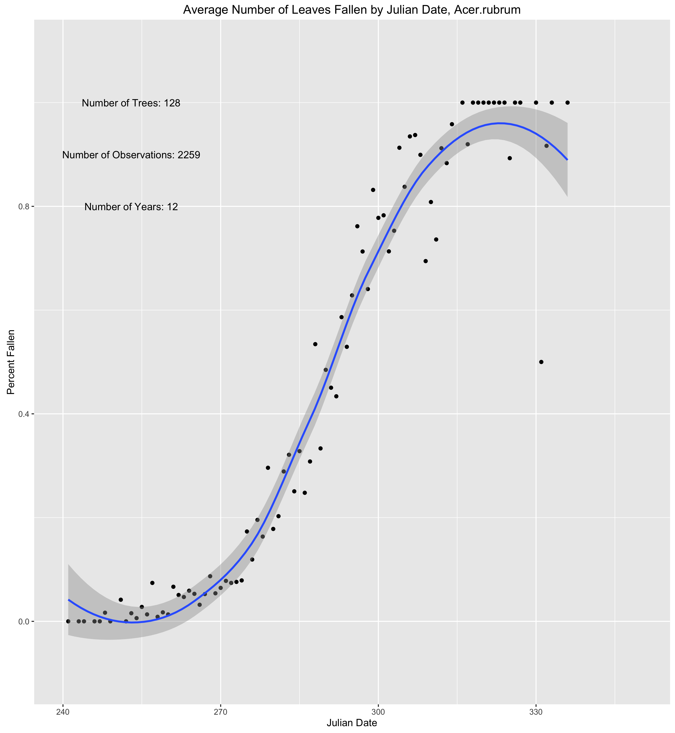
Acer rubrum

Slide 15
Betula lenta

Slide 16
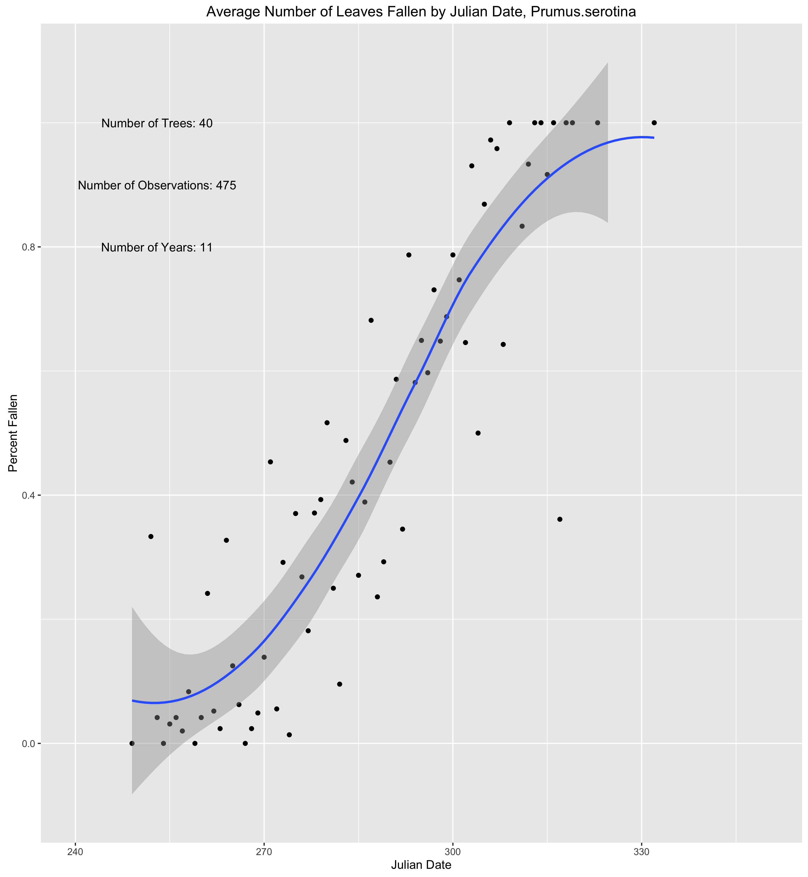
Prunus serotina

Slide 17
Prunus serotina

Slide 18
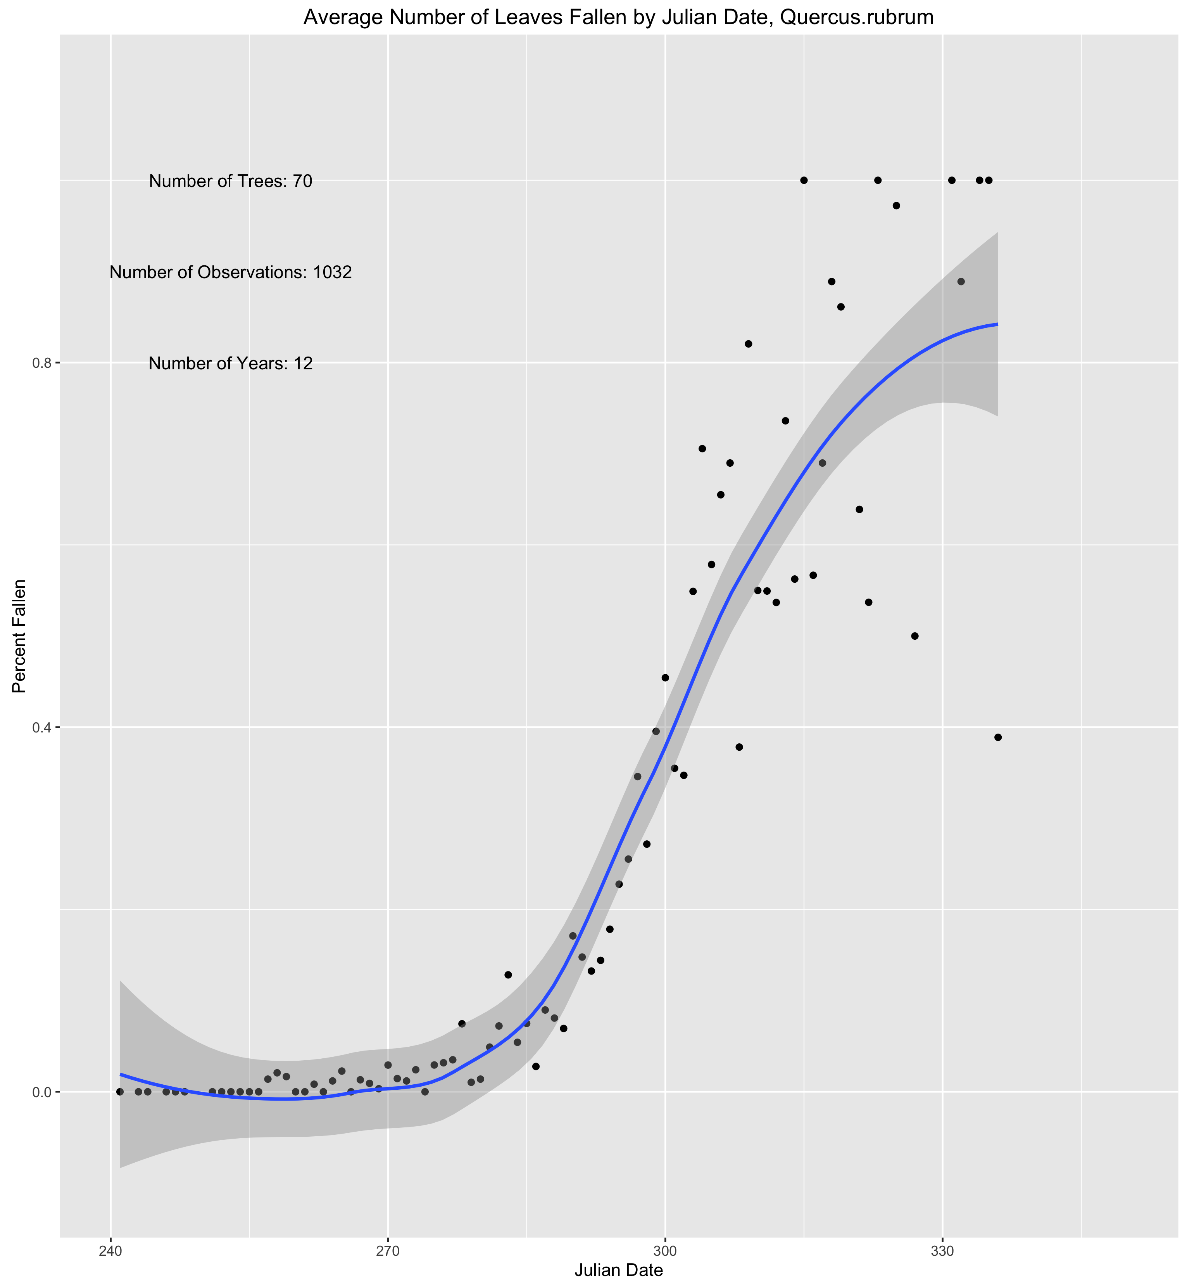
Quercus rubrum

Slide 19
Quercus rubrum

